Slide 1
ERASMUS
Committee Meeting
7 March 2019
2013
2016
Notes:
21:47
AGÜ Gençlik Fabrikası
Gençler için gençlerle birlikte daha iyi bir topluma...
Türkiye’de bir ilk olan Gençlik Fabrikası:
• gençleri eğiten,
• yaratıcı ve girişimci olmaya teşvik eden,
• gençlere yaşama dair beceriler kazandıran,
• uluslararası vizyon katan,
• gençlerin toplumsal hayata katılımını sağlayıp bir arada öğrenmenin ve üretmenin keyfine vardıran,
• ulusal ve uluslararası boyutta faaliyet gösteren öğrenen odaklı bir yapıdır.

Slide 2
Agenda Items
Erasmus Staff Presentations
Erasmus Staff Exchange Selections
Erasmus Student Exchange 2019 (new quotas and exam passing grade, selection criteria for study and internship mobility)
Discussion on the next plans and meetings
2013
2016

Slide 3
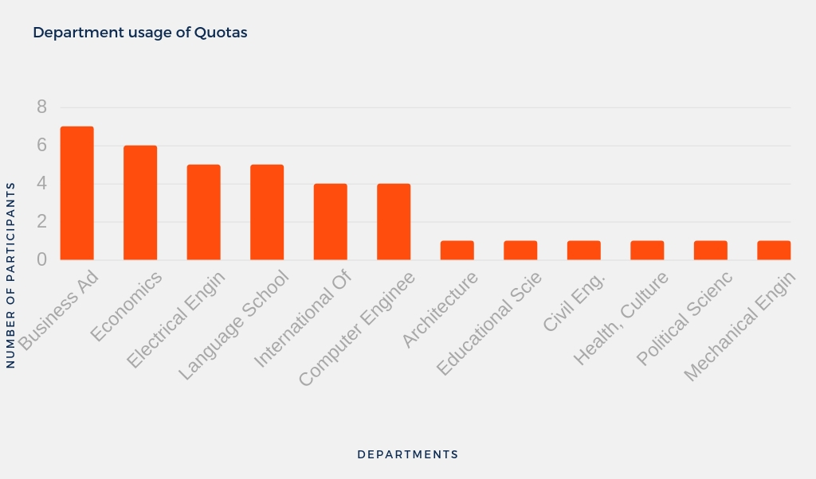
Staff Mobilty@AGU
2013
2016

Slide 4
Staff Mobilty@AGU 2018-2020
 | Number | Dates
Teaching Mobility | 3 | Until 2020
Training Mobility | 2+1 | Until 2020
2013
2016

Slide 5
New Applications
Name | Department | Experience | Country | Institution | Dates | Mobility Type
Elif Bengü | Educational Sciences | 2,5 years | Spain | Create the future leaders & innovators in the classroom (CLIC) | 22-26 April 2019 | Training
Uğur Doğan | Educational Sciences | 4 years | Czech Republic | ITC-International TEFL Certificate | 15-19 July 2019 | Training
Betül Kayışoğlu | Industrial Engineering | 5,5 years | UK | NATCOR | 9-13 September 2019 | Training
Hakan Gover | AGU Language School | 7,5 years | UK | PMS Plus | 14-20 July 2019 | Training
Fatih Yalçın | AGU Language School | 7,5 years | UK | ITC-International TEFL Certificate | 5-7 August 2019 | Training
Emeric Abrignani | International Office | 5 years | Estonia | Tallin University of Technology | 6-9 May 2019 | Training
Burak Bal | Mechanical Engineering | 2,5 years | Lithuania | Kaunas University of Technology | 29 April-3 May 2019 | Teaching
2013
2016

Slide 6
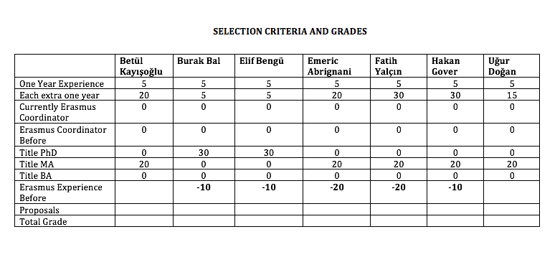
New Applications
2013
2016

Slide 7
Erasmus@AGU 2018-2020
Criteria for staff mobility:
At least one year of work experience at AGU: + 5 points
For each extra year of work experience at AGU: + 5 points
Currently, Erasmus Department Coordinator/Assistant: +10 points
Previous Erasmus Department Coordinator/Assistant: + 5 points
First time Erasmus applicant: +30 points
Academic personnel of Faculties/Schools with Ph.D. Titles: +30 points
Support academic personnel of Faculties/Schools with M.Sc./M.A Titles: +20 points
Support academic personnel of Faculties/Schools with B.Sc./B.A Titles: +10 points
2013
2016

Slide 8
Erasmus@AGU 2018-2020
Criteria for staff mobility:
Language Level 1 : + 40 points for KPDS/YDS .GE. 90, TOEFL IBT .GE. 108
Language Level 2 : + 30 points for KPDS/YDS .GE. 80, TOEFL IBT .GE. 96
Language Level 3 : + 20 points for KPDS/YDS .GE. 70, TOEFL IBT .GE. 84
Language Level 4 : + 10 points for KPDS/YDS .GE. 60, TOEFL IBT .GE. 72
Here .GE. stands for “Greater than or Equal to”. One can get a Language Point from only one of the Language Levels.
For presentation proposals that introduces the research activities, their budgets and the project based RA scholarships at AGU: +10 points
For presentation proposals that promotes the joint research collaborations between the two institutions: +10 points
For presentation proposals that promotes graduate studies at AGU for candidate grad students: +10 points
For presentation proposals that promotes academic exchange activities between the two institutions: +10 points
For presentation proposals that promotes undergrad and grad student exchange activities between the two institutions: +10 points
2013
2016

Slide 9
Erasmus@AGU 2018-2020 Student Mobility
Minimum passing score for the English Proficiency Exam?
21 study mobility (9 departments)
22 internship mobility
9 internship Erasmustern
UNTIL 2020
Quota distribution between the departments?
2013
2016

Slide 10
13 February 2019 Exam Results
STUDENT MOBILITY EXAM
288 Applications
257 Valid Applications (2.20 GPA and higher)
54 did not enter the exam
203 students took the exam
38 students higher than 50 points
67 students higher than 40 points
103 students higher than 30 points
134 students higher than 20 points
164 students higher than 10 points
8 students = “0”
2013
2016

Slide 11
Architecture
 | Name - Surname | Score
1 | Azizeh Salimipoor | 87
2 | Mohit Purshotam | 68
3 | Cansu Ünal | 68
4 | Betül KELEŞ | 59
5 | Berfin Nur Şahin | 45
6 | Luka Tavzarashvili | 43
7 | Oruç Türk | 41
8 | Fatma Nur Işık | 41
9 | Emire Nur Solmaz | 40
10 | Rabia şeybek | 39
11 | Muharrem Melih Utkan | 38
12 | Görkem Kemal Şahin | 38
13 | Gülistan Kenanoğlu | 32
14 | Meltem Bedir | 32
15 | Gamze DEVECİ | 31
16 | Gülsüm Oygur | 30
17 | ESMA NUR DEMİR | 26
18 | Aysu Şenbaş | 25
19 | Hazal Burçin Eser | 25
20 | Zeynep Sultan Çakır | 25
21 | Şeyma Şahin | 25
22 | Hilal Ünal | 24
23 | Havva Gök | 24
24 | Ali Rıza UYGUN | 14
25 | Gökhan GEDİK | 12
26 | Çağlar Hanaylı | 10
27 | Şeyma Sağlam | 9
28 | Havvanur Özgüven | 6
29 | Dilara Çiftçi | 5
30 | Rukiye ER | 2
31 | Ufuk Alakaş | 2
32 | Enes özdin | 1
33 | Asli Aksakal | 1
34 | İsmet SAYIN | 0
35 | yavuz selim sulan | 0
2013
2016

Slide 12
Business Administration
 | Name - Surname | Score
1 | Yumna Haq | 86
2 | Yakup Can Avcı | 85
3 | Muhammad Firghili | 70
4 | Kübra Delibaş Daldıran | 61
5 | Mustafa Utku Sarıkaya | 56
6 | Mirriam Manyando | 52
7 | Aya Allali | 51
8 | Berfin Ekren | 48
9 | İlayda Doğanay | 45
10 | Yasmine Es-slassi Razzouki | 43
11 | Hüseyin VAYVAYLI | 41
12 | Burak Kalkan | 40
13 | BÜNYAMİN DALDIRAN | 39
14 | Yasir Çakmak | 31
15 | Ali Tuğrul Binköl | 14
16 | Habibe Sultan Özhan | 7
17 | Yasin Bayram | 6
18 | Edanur Sakarya | 3
19 | Mustafa Altun | 1
20 | Ahmet Musab İMİR | 0
2013
2016

Slide 13
Civil Engineering
 | Name - Surname | Score
1 | MHD.GHAITH KHIDRAH | 39
2 | Emre Özdin | 29
3 | Kaya Berk Livdumlu | 28
4 | Erdinç Özer Çiftekuş | 23
5 | Sibel Selcan Çolak | 23
6 | lokman günay | 22
7 | MOATAZ BASBAA | 18
8 | Zekai Top | 17
9 | Ömer Faruk BALALAN | 16
10 | Mert Can Başkaya | 10
11 | Salem alkhulaqi | 10
12 | Faruk ALDEMİR | 8
13 | ENES BÜYÜK | 6
14 | FERHAT HAKAN | 5
15 | ENSAR DURAN | 0
2013
2016

Slide 14
Computer Engineering
 | Name - Surname | Score
1 | Yzeir Baku | 87
2 | Patrick Sibale | 84
3 | Hamdi Burak Usul | 74
4 | Kerem Gürler | 66
5 | Ümit YILMAZ | 64
6 | Enes Haluk Öztürk | 59
7 | Halil Ibrahim Bilgin | 52
8 | Melike Doğru | 47
9 | Abdullah Tahir | 45
10 | Mustafa Kemal Özdemir | 39
11 | Taha Yasin Mimarlar | 38
12 | Mansur Muaz Ekici | 33
13 | Ozan Karaali | 31
14 | Ahmet Sayıcı | 30
15 | Halit Boyar | 30
16 | Fatih Coşkun | 29
17 | Muhammet Abdullah Soyturk | 29
18 | Bahadır Korumaz | 28
19 | Sena Çelebi | 23
20 | Hüseyin Fadullah Güngör | 23
21 | Mahsun ALTIN | 18
22 | Alperen Çınar | 10
23 | Enes Kaçan | 7
24 | Veysel Karani Pehlivan | 2
25 | McDonald Chimzere | 2
2013
2016

Slide 15
Electrical Engineering
 | Name - Surname | Score
1 | Ali Mohamed Ali | 75
2 | Yahya Güneş | 62
3 | Harun Çalışkan | 61
4 | Muhammet Furkan Nargül | 61
5 | Burak Rüştü Duman | 58
6 | Sayed Areeb Qadri | 55
7 | Mehmet Can BOZ | 54
8 | Furkan Serper | 49
9 | Burak Fatih ASLAN | 46
10 | Muratcan YAZICI | 41
11 | Mustafa Yıldırım | 41
12 | Huseyin Baydar | 40
13 | MOHAMED FARAH ABDILAHI | 37
14 | Ömer Faruk Demirci | 32
15 | Melih Aslan | 28
16 | Malek Hamid Ahmed Shahrah | 23
17 | Halid ALABAY | 18
18 | DHIA EL HAK DAAMOUCHE | 17
19 | Osman SARAÇ | 16
20 | Durmuş TORUNER | 16
21 | ABDULLAH HAMDY HUSSEIN SOWILAH ASHOUR | 10
22 | Rüstem AĞAOĞLU | 10
23 | Ahmet Furkan Haçan | 10
24 | Muhammed Salim Aksoy | 7
25 | TALHA YILDIRIM | 5
26 | Orhan Demirci | 3
27 | Fatih Muhammed TUZTAŞI | 2
28 | Burak Bozaba | 2
29 | ABDULLAH HAYIRLI | 1
30 | Can Ramazan YILMAZ | 0
2013
2016

Slide 16
Industrial Engineering
 | Name - Surname | Score
1 | Sibel ALİM | 71
2 | Serra Berşan Gengeç | 69
3 | Muhammed Fatih Özer | 62
4 | Yakup Kapar | 55
5 | Omar Samak | 49
6 | Lütfiye Aykaç | 49
7 | Osman Hassan Osman | 48
8 | Fatih İNCE | 45
9 | Aladdin Demirkan | 44
10 | Sevde Ilgaz Kanalmaz | 37
11 | Çağrı Gürbüz | 36
12 | Zülfiye Derin | 35
13 | Ayça Sarıkaya | 33
14 | Hande DERİN | 32
15 | Şengül Timuray | 31
16 | Merve Demirci | 30
17 | Zeynep Büşra DOĞAN | 30
18 | Cemre Nur YILMAZ | 25
19 | Sevde Zülal Uysal | 25
20 | Ahmed Marwan Abdulhabeb AL-QERSHI | 24
21 | Nükhet ARI | 23
22 | Fatih Yasin Güner | 22
23 | Muhammet Mustafa Öztürk | 18
24 | Kübra Kurtoğlu | 15
25 | Tenzile Yıldırım | 10
26 | Enes Sedat ÇAĞLAR | 10
27 | Rabia Işılak | 9
28 | RIDVAN ŞAHİN | 8
29 | Canan Aslı Altıok | 2
30 | Hüseyin ALTINSOY | 0
2013
2016

Slide 17
Mechanical Engineering
 | Name - Surname | Score
1 | Khuzaima Jillani | 82
2 | Bilge ÖKDEM | 81
3 | Syed Faiz Ali | 71
4 | Süleyman Çiçek | 64
5 | Masud Malikli | 62
6 | Ahmet Kılavuz | 58
7 | Abdülkadir Yılmaz | 58
8 | Yasin Yılmaz | 51
9 | Fasih Malik | 49
10 | Can Yıldız | 45
11 | Engin Can Öcan | 45
12 | memiş özdeş | 40
13 | Mücahit Han | 36
14 | AYŞE NUR BÜYÜKER | 33
15 | Musa Kasım Ağca | 32
16 | Cemil Faruk Yalçınkaya | 31
17 | Ahmet safa aydoğdu | 30
18 | Muhammet Mustafa Etik | 29
19 | Onur Metin Mertaslan | 28
20 | Cevher Yusuf İNAN | 26
21 | Moaaz Safwa | 23
22 | YUNUS CULFA | 21
23 | Mehmet Kara | 20
24 | mehmet selman incesu | 17
25 | Furkan Çetinalp | 15
26 | Ridvan Buyukcapar | 14
27 | Ahmed Çağrı Sayın | 13
28 | BAHRI ERKAM YAYLAMAZ | 12
29 | Mehmet POLAT | 12
30 | Hina Najam | 7
31 | Mahmut Alp EREN | 5
32 | Zeki Çatlı | 0
33 | Rukiye DEMİR | 0
2013
2016

Slide 18
Molecular Biology
 | Name - Surname | Score
1 | Ghazi Al Ali | 83
2 | Ahsen KONAÇ | 47
3 | Hande Nur SAHIN | 41
4 | Fulya Mina Küçüktaş | 41
5 | Furkan Büyükgöl | 39
6 | Maham Khokhar | 35
7 | Batuhan Altay | 31
8 | Halenur Ayaydın | 31
9 | İrem Sultan Dilbaz | 30
10 | MHD. Wardan Hawa | 26
11 | Furkan M. Torun | 15
12 | kardelen gökçen | 15
13 | Eda nur arslantaş | 9
14 | Ecem Metin | 2
15 | Didem BAYRAKTAROĞLU | 2
2013
2016

Slide 19
What’s next?
Next Call
Next Committee Meeting
2013
2016

Slide 20
Thank you for your participation!
2013
2016

